Slide 1
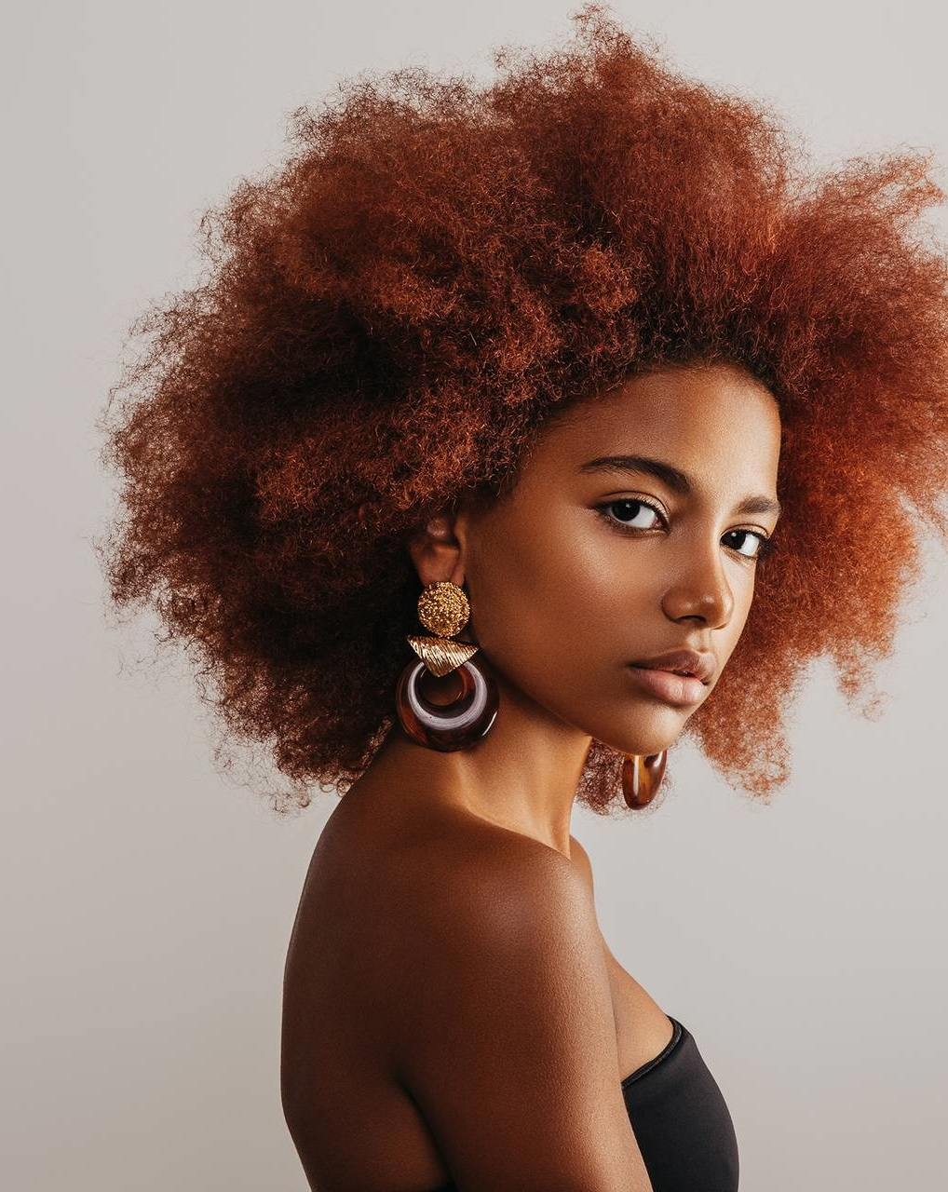

Naturus Life
Radiant, Youthful, & Confident

Slide 2
Problem Definition
Consumers want to move to natural and sustainable, but face several hindrances!
Ingredient choice
Certain ingredients cause allergic reactions, skin irritation or not produce desired result
Not really natural
In some large markets such as India, products advertised as natural actually aren’t
Expensive
High price is impeeding market growth
Confusion
Among consumers due to use of several terms such as clean, green, safe, non-toxic, etc.
Source: Media articles and market reports.
Notes:
https://economictimes.indiatimes.com/industry/cons-products/fashion-/-cosmetics-/-jewellery/are-herbal-products-really-that-natural-as-advertised-in-india/articleshow/63660208.cms?from=mdr
https://www.technavio.com/report/natural-and-organic-personal-care-product-market-industry-analysis
https://www.vox.com/the-goods/2018/9/18/17866150/natural-clean-beauty-products-feinstein-cosmetics-bill-fda
https://integrisok.com/resources/on-your-health/2019/january/the-truth-about-all-natural-skin-care#:~:text=Natural%20and%20organic%20products%20can,toning%2C%20acne%20treatment%20or%20moisturizing.

Slide 3
PROBLEM EXAMPLE
Winning strategy in skin care needs a personalized approach, because skin care is close to heart!
97% love to try new facial skin care products
89% willing to spend more on higher quality facial skin care products
89% always on the lookout for new facial skin care products
88% share knowledge of facial skin care products with friends and family
81% seek out advice/recommendations from friends on facial skin care products
80% are always on the lookout for something better, even if satisfied with her current skin care
Percent of women’s whose skin care needs are unmet
71%
It is personal!
“38% see it as “me time”, and say the more steps, the better.”
Notes:
https://www.cormedspa.com/71-of-women-arent-satisfied-with-their-skin-care-but-you-can-be-denville-nj/

Slide 4

SOLUTION
Genuinely natural product with a secret recipe at affordable prices through clear messaging.
Personalized and educational messaging at a large scale
Best of Brazil
Pure, clean and tested natural ingredients
WhatsApp
Affordable
With efficient operations and reasonable margins
Instagram
Clear messaging
Honest, clear, effective communication about the product
Right combination
Deliver the desired results in skin care
Consumer Forums (e.g. Quora)
Source: Media articles and market reports.
Notes:
https://economictimes.indiatimes.com/industry/cons-products/fashion-/-cosmetics-/-jewellery/are-herbal-products-really-that-natural-as-advertised-in-india/articleshow/63660208.cms?from=mdr
https://www.technavio.com/report/natural-and-organic-personal-care-product-market-industry-analysis
https://www.vox.com/the-goods/2018/9/18/17866150/natural-clean-beauty-products-feinstein-cosmetics-bill-fda
https://integrisok.com/resources/on-your-health/2019/january/the-truth-about-all-natural-skin-care#:~:text=Natural%20and%20organic%20products%20can,toning%2C%20acne%20treatment%20or%20moisturizing.

Slide 5
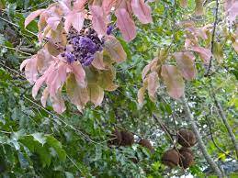
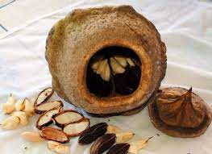
SOLUTION Example
Sapucainha: Extracted from a tree in Brazil
Skin benefits of Sapucainha:
High in essential fatty acids
Prevents skin damage from 99.6% of the negative effects of pollution
Protects against signs of premature aging, including wrinkles, sagging, and dark spots
Source: Media articles and market reports.
Notes:
https://www.refinery29.com/en-us/natural-ingredients-natura#:~:text=What%20is%20it%3A%20Extracted%20from,%2C%20sagging%2C%20and%20dark%20spots.

Slide 6
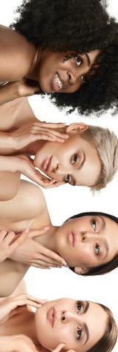
LaunchES for Year 1
Facewash
Vitamin C Facewash
Sunscreen Lotion
Mineral Sunscreen SPF 50+ PA++++
Advance Skin Cream
Day Cream
Anti Wrinkle Cream
Skin Brightening Cream
White Expert Brightening Serum Cream (for face)
*Initially we will launch with two products in the Brazilian market.
Notes:
https://www.grandviewresearch.com/industry-analysis/organic-skin-care-market
https://www.grandviewresearch.com/industry-analysis/skin-care-products-market

Slide 7
GLOBAL Market potential 2023
Our opportunity size expands to the entire beauty & personal care products market and beyond!
Those not using skincare products today, unaware / disbeliever of its benefits.
TAM
US$571.10bn
SOM
Beauty & personal care market
US$600+ bn
Those not satisfied with their skincare products today
SAM
US$13.4bn
Those using natural skincare products today
Natural skincare products market
Notes:
https://economictimes.indiatimes.com/industry/cons-products/fashion-/-cosmetics-/-jewellery/are-herbal-products-really-that-natural-as-advertised-in-india/articleshow/63660208.cms?from=mdr
https://www.technavio.com/report/natural-and-organic-personal-care-product-market-industry-analysis
https://www.vox.com/the-goods/2018/9/18/17866150/natural-clean-beauty-products-feinstein-cosmetics-bill-fda
https://integrisok.com/resources/on-your-health/2019/january/the-truth-about-all-natural-skin-care#:~:text=Natural%20and%20organic%20products%20can,toning%2C%20acne%20treatment%20or%20moisturizing.

Slide 8
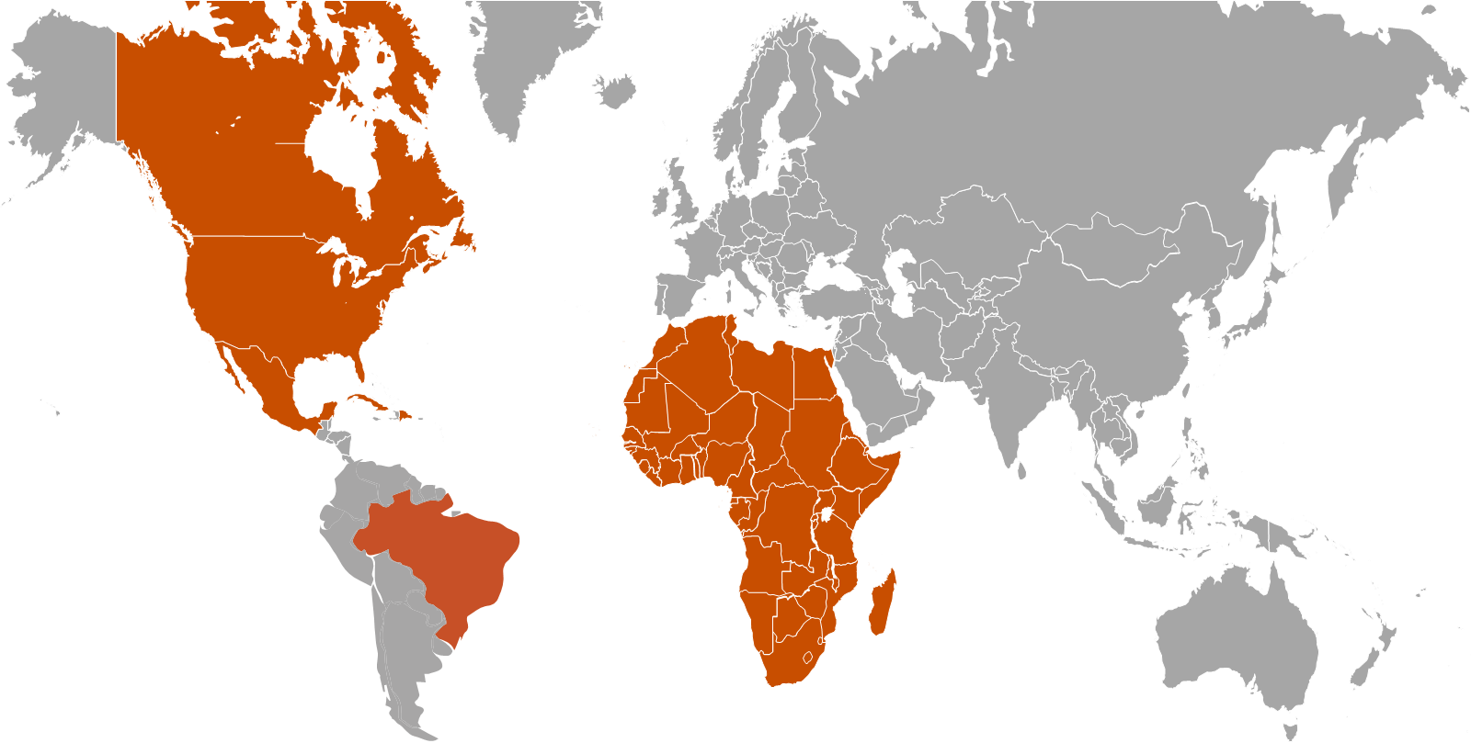

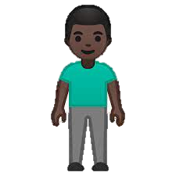
TARGET CUSTOMERS
Our products are suited for every person, however given our heritage and origin we believe that our products would appeal the most to millennials, especially the people of color.
Primary demographic group:
Primary locations and size of target demographic:
Millennials
35M
People of color: Latino, Africans, etc.
278M
34M
Notes:
https://www.milkenreview.org/articles/millennials-under-the-microscope
https://www.visualcapitalist.com/sp/a-regional-breakdown-of-millennials-around-the-world/

Slide 9
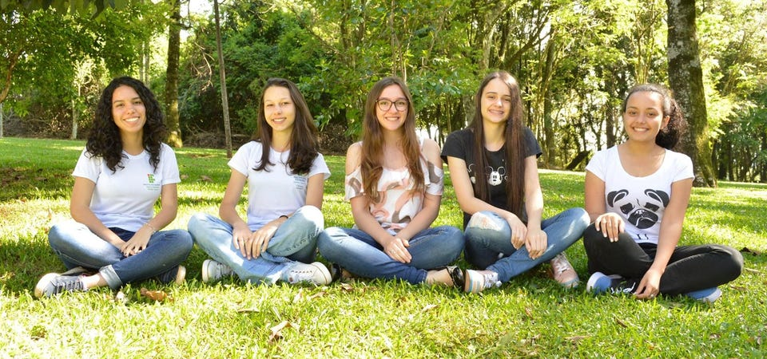

Deeply entrenched in Brazil
With years of experience in Brazil, we know exactly what is needed to succeed!
Experience
Professionals in the market
Deep knowledge
Existing factory for supporting activities
Multi-channel sales
D2C, beauty salons, and distributors
Partner
Existing factory for supporting activities
Secret ingredient
Product will include a proven natural ingredient
Established Network
Established relation with beauty product buyers
Precise Pricing
A sweet spot where customers love to try new products
Notes:
https://www.milkenreview.org/articles/millennials-under-the-microscope
https://www.visualcapitalist.com/sp/a-regional-breakdown-of-millennials-around-the-world/

Slide 10
Value proposition
Product PORTFOLIO
customer PORTFOLIO
Category
Sub-Category
Variants
Wants
Fears
Gets
Face Care
Skin Care
Hair Care
Facewash & Skin Brightening
Sunscreen
Shampoo
4 variants
2 variants
3 variants
Flawless Skin
Natural product
Safety from harmful UV rays
Natural makeup products
Skin diseases
Flawed appearance
Pricey products
Harmful products
Natural Astragalus & Sapucainha extracts
Best moisturizing agent
Unisex makeup products

Slide 11
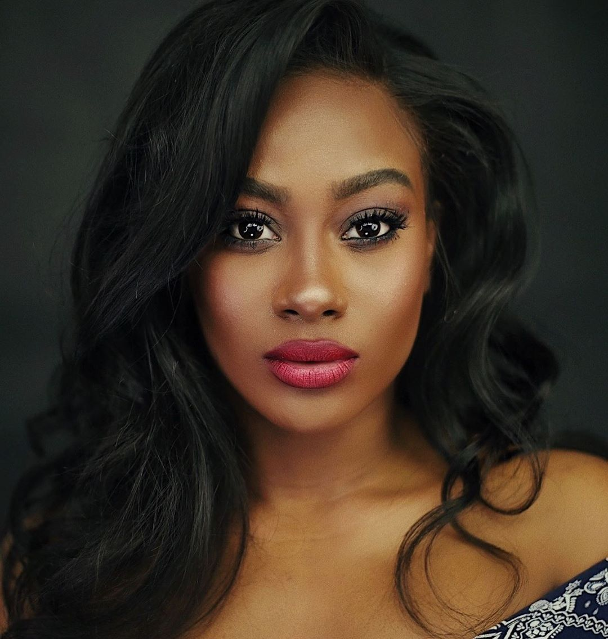
We are our own competition
Our product
Competitive research
Patented purity of Ingredients
Potency
Penetration
Performance
Products are more expensive
They claim to be natural however only few are
Products focus on wider markets hence emphasis to GenZ & GenY is least
Our products will serve as our benchmark and we will strive to improve it through a strong feedback loop that we will establish with out customers.

Slide 12
Financial SUMMARY

Slide 13
Product launch plan
Pre-roll out
Roll out product to local region
Pre-release
Product public release
Feedback
Gather feedback and fix bugs
Announce
Public preview and announcement
Launch
General product release

Slide 14
Round 1 FUND UTILIZATION

Slide 15
FUNDING roadmap
Pre operations
$0.3M
1st year of operations
$3M
2nd year of operations
$2M
3rd year of operations
$1.2M
Equity stake offered
1.0%
Equity stake offered
15.7%
Equity stake offered
9.1%
Equity stake offered
3.2%
At pre-money valuation
$15.8M
At valuation
$19.1M
At valuation
$22.1M
At valuation
$38.0M

Slide 16
Invest NOW FOR MAXIMUM RETURNS!
$15.8M
Pre-money valuation
$71.7M
Post-money valuation at end of year 5
ROI: 454.2%
DCF valuation method
Revenue multiple method at 2.5x (industry average)
Notes:
https://valuanalytics.com/beauty-product-company-valuations-june-2022/

Slide 17
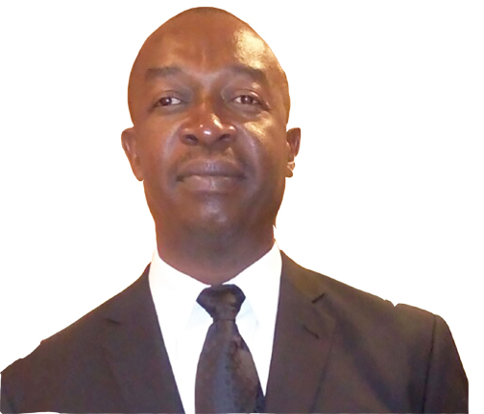
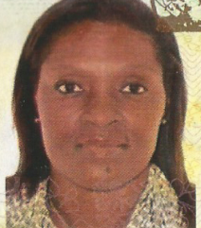
Our team (1/3)
Sidney L Strachan
CEO/Founder
Ingrid R. Black
COO/Partner
Conceptualize and orchestrate marketing campaigns to effectively reinforce and build brand images, Sales Collateral & Support. Background in business ownership and management including: wholesale & retail (Food Store, Cosmetic & Beauty (Beauty Salon), Market Research and online sales). Sidney has worked for himself and part-time in banking (currently) for more than 25 years. He has been excellent; through his successes with CARIMAN, Caribbean Male Action Network, at putting together working groups in different part of the world. Sidney has a strong affinity for working with international organization in a leadership capacity
An astute, innovative and versatile professional, offering a rich mixture of experience and success in the business world. A Business Degree and Bachelor Degree in Languages (German & French). Integrity, excellent organizational and leadership abilities and strong interpersonal, communication skills, demonstrate an aptitude for decision-making, problem-solving, competence in strategic planning, business development, regulatory issues and setting comprehensive goals for performance and growth with a background in numerous ownership, business operations and management including high-end beauty and clothing.

Slide 18
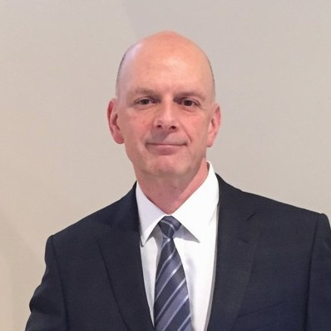
Our team (2/3)
John Smyk, CPA, MBA
CFO/Partner
Innovative, Empowering, Strategic I The Entrepreneurial CPA | Business Integration For Entrepreneurs, Clients, Investors | CFO In Demand | Startup Driven | Father | Millennial Mentor.
Provide fractional Chief Financial Officer (CFO) solution services for small and medium sized businesses that do not require a full-time permanent employee. Consultation and advisory services for project management tailored including business startups, newly operated businesses, and businesses experiencing expansion.

Slide 19
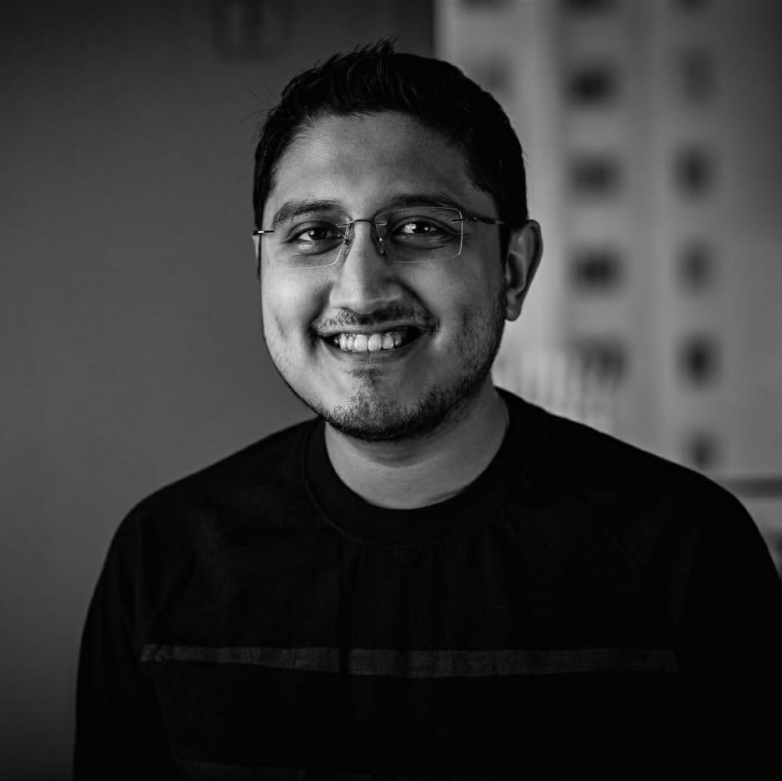
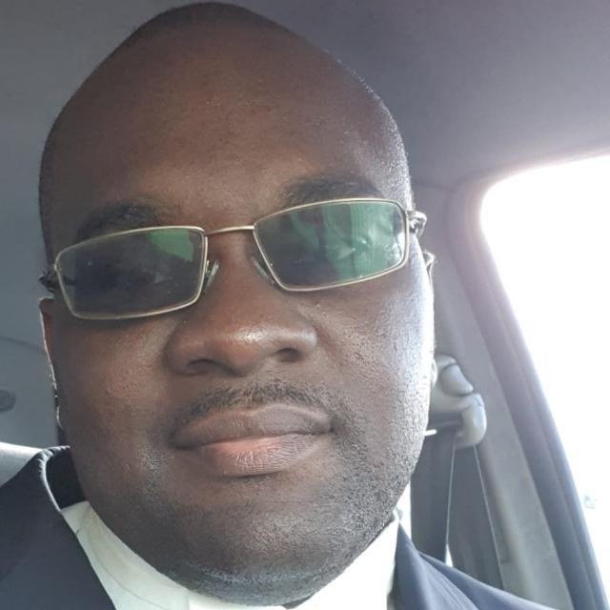
Our team (3/3)
Niladri Chakravarty
Business Development/Co-Founder
Shivron Gay
Attorney-at-law
Niladri has been working in Business and Strategy roles over the past 12 years, with focus on profitability, brand building, product and business development and operation. So far, he has been able to help organizations build their businesses to $50mn and more. As a C-Suite executive, he has created new revenue streams while complementing larger business goals. He has also successfully laid out ground breaking processes while overseeing their implementation across the board. He is particularly curious and spends a lot of time understanding how a combination of strategical business decisions and product constructs can have an everlasting impact on customer experience, possibly defining a crucial stepping stone in recurring organizational profitability. In his free time, he loves spending time with his two dogs, Shadow and Whiskey.
Shivron Gay is a Bahamian attorney who has reviewed documents and assisted the company throughout 2021. He is a dynamic young attorney who has transitioned from the world of offshore banking and finance after many years.
His office is located in Cable Beach, the Western District of New Providence.

Slide 20
Sidney Strachan
242-535-2399 naturuslife@gmail.com www.naturuslife.com www.naturuslife.com.br
Thank
thank
Thank
You
You
You
you
Thank you

